Slide 1
CMSC201 Computer Science I for Majors Lecture 22 – Project 3 and Miscellaneous Topics

Slide 2
Last Class We Covered
Dictionaries
Creating
Accessing
Manipulating
Methods
Hashing
Dictionaries vs Lists

Slide 3
Any Questions from Last Time?

Slide 4
Today’s Objectives
To understand more about how data is represented inside the computer
ASCII values
To see the benefits of short circuit evaluation
To discuss details of Project 3
How many boards to have?

Slide 5
ASCII Values

Slide 6
ASCII Values
ASCII is how text is represented in computers
Just like binary is how numbers are represented
In ASCII, every character has a unique, individual numerical code
Lowercase and uppercase characters are separate
Codes go from 0 to 127
Why 127?

Slide 7
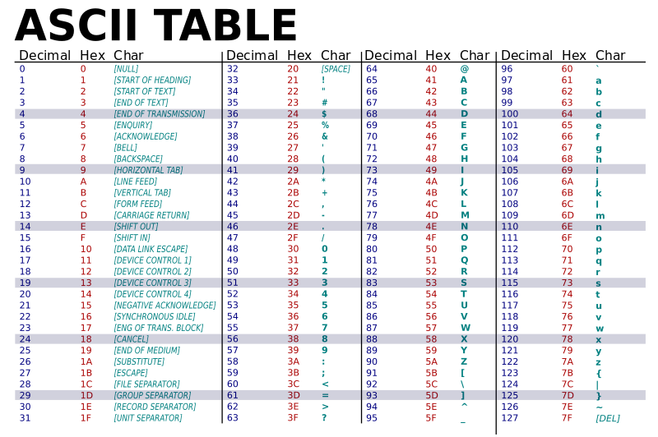

Slide 8
“control” characters
uppercase letters
symbols & numbers
lowercase letters

Slide 9
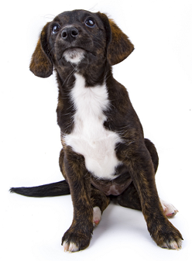
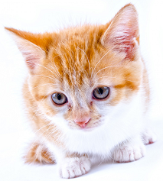
Comparing Strings
The values of the ASCII characters are used when comparing strings together
Which can lead to some “weird” results
>>> "cat" < "dog"
True
>>> "cat" < "Dog"
False
>>> "DOG" < "dog"
True
?
<

Slide 10
More on Comparing Strings
Gets even more complex when you start adding in numbers and symbols
>>> "2" < "one"
True
>>> "good?" < "good!"
False
>>> "UK" < "U.K."
False

Slide 11
Rules for Comparisons
To avoid (some) of these issues:
Always use .lower() for comparing strings
Pay attention to symbols
e.g., spaces, hyphens, punctuation, etc.
Either remove them, or keep them in mind as part of the order

Slide 12
ASCII Characters to ASCII Values
We can convert between ASCII characters and their values using ord() and chr()
The ord() function takes in a single character, and returns its ASCII value
The chr() function takes in an integer, and returns its ASCII character

Slide 13
Using chr() and ord()
>>> chr(65)
'A'
>>> chr(65+32)
'a'
>>> ord('?')
63
>>> ord("d")
100
>>> ord("e")
101

Slide 14
“Short Circuit” Evaluation

Slide 15
Review: Complex Expressions
We can put multiple operators together!
bool4 = a and (b or c)
What does Python do first?
Computes (b or c)
Computes a and the result
This isn’t strictly true!

Slide 16
Short Circuit Evaluation
Python tries to be efficient (i.e., lazy), and so it won’t do any more work than necessary
If the remainder of an expression won’t change the outcome, Python doesn’t look at it
This is called “short circuiting”
It’s a powerful tool, and can simplify the conditionals in your programs

Slide 17
Short Circuit Evaluation – Rules
For obvious reasons, short circuiting behaves differently for and and or statements
“and” statements short circuit as soon as an expression evaluates to False
“or” statements short circuit as soon as an expression evaluates to True

Slide 18
Short Circuiting – and
Notice that in the expression:
bool1 = a and (b or c)
If a is False
The rest of the expression doesn’t matter
Python will realize this, and if a is False won’t bother with the rest of the expression

Slide 19
Short Circuiting – or
Notice that in the expression:
bool1 = a or (b or c)
If a is True
The rest of the expression doesn’t matter
Python will realize this, and if a is True won’t bother with the rest of the expression

Slide 20
Causing Errors
This can lead to “new” errors in old code
>>> a = True
>>> # Variables b and c not defined
>>> a or (b and c)
True
>>> a = False
>>> a or (b and c)
Traceback (most recent call last):
File "<stdin>", line 1, in <module>
NameError: name 'b' is not defined
Python stopped at the “or”, so it never saw b or c

Slide 21
Simplifying Conditionals
Order matters! You can use short circuiting to control what statements are reached
While checking the validity of input, if the user can also enter a “Q” to quit
if num != QUIT and int(num) > MIN_VAL:
return num
This will only be reached if num is not “Q”, so the cast to int() won’t cause a problem

Slide 22
Project 3

Slide 23
Do Not Cheat on Project 3
Yes, this project has been given before
Yes, in this class
Yes, we have all of the old projects to compare it to
Yes, this project has solutions on the internet
Yes, we have copies of all of them
Yes, we will go looking for new ones after it’s due
Yes, you could pay someone else to do it
Yes, we know of the sites where you can get this done
Yes, we will spot “elegant” code that you didn’t write

Slide 24
Boards in Project 3
Discussed in class
¯\_(ツ)_/¯

Slide 25
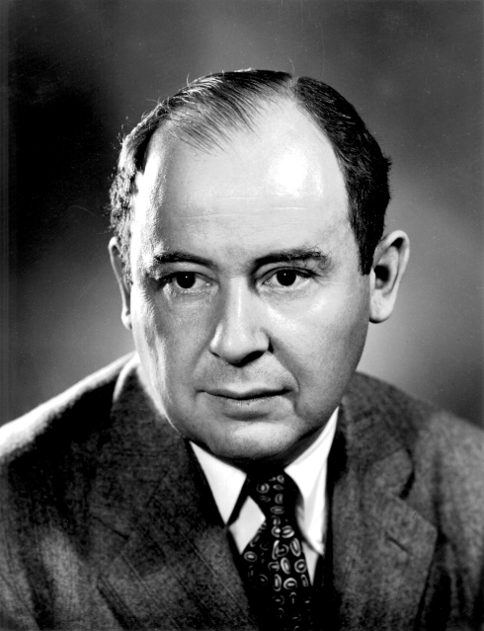
Daily CS History
John von Neumann
Creator of merge sort
We’ll learn this soon!
Helped develop what is now known as “von Neumann architecture” (not all his work)
Created a rigorous framework for quantum mechanics
Developed implosion mechanism for nuclear bombs

Slide 26
More Daily CS History
ENIAC
Completed in 1946 at UPenn
Decommissioned in 1956
Computations were 2,400 times faster than humans
Cost $6.7 million to build
Meant to create artillery firing tables for the US Army
Also used for studying thermonuclear feasibility

Slide 27
Even More Daily CS History
ENIAC Programmers
Kay McNulty, Betty Jennings, Betty Snyder, Marlyn Meltzer, Fran Bilas, and Ruth Lichterman
These women turned abstract ideas into working, bug-free code
First program run on ENIAC had a million individual punchcards
Programming was seen back then as “easy” work, akin to typing up a handwritten letter

Slide 28
Announcements
Project 3 design is due on Friday, May 4th
Project itself is due on Friday, May 11th
Survey #3 out on Monday, May 7th
Final exam metacognition quiz out on BB same day
Course evaluations are (not out yet)
Final exam is when?
Friday, May 18th from 6 to 8 PM

Slide 29
Final Exam Locations
Find your room ahead of time!
Engineering 027 - Sections 8, 9, 10, 11, 12
Section 6
Meyerhoff 030 - Sections 2, 3, 4, 5
Sections 14, 15, 16, 17, 30

Slide 30
Image Sources
ASCII table (adapted from):
https://commons.wikimedia.org/wiki/File:ASCII-Table-wide.svg
Generic kitten:
http://www.publicdomainpictures.net/view-image.php?image=87454
Generic puppy:
http://www.publicdomainpictures.net/view-image.php?image=192231
John von Neumann:
https://en.wikipedia.org/wiki/File:JohnvonNeumann-LosAlamos.gif
ENIAC (adapted from):
https://commons.wikimedia.org/wiki/File:Eniac.jpg
ENIAC programmers (adapted from):
https://commons.wikimedia.org/wiki/File:Reprogramming_ENIAC.png
Mad emoji (adapted from):
https://commons.wikimedia.org/wiki/File:Twemoji_1f620.svg

